Slide 1




DIGITAL LITERACY
SKILLS
BASIC USERS

Slide 2
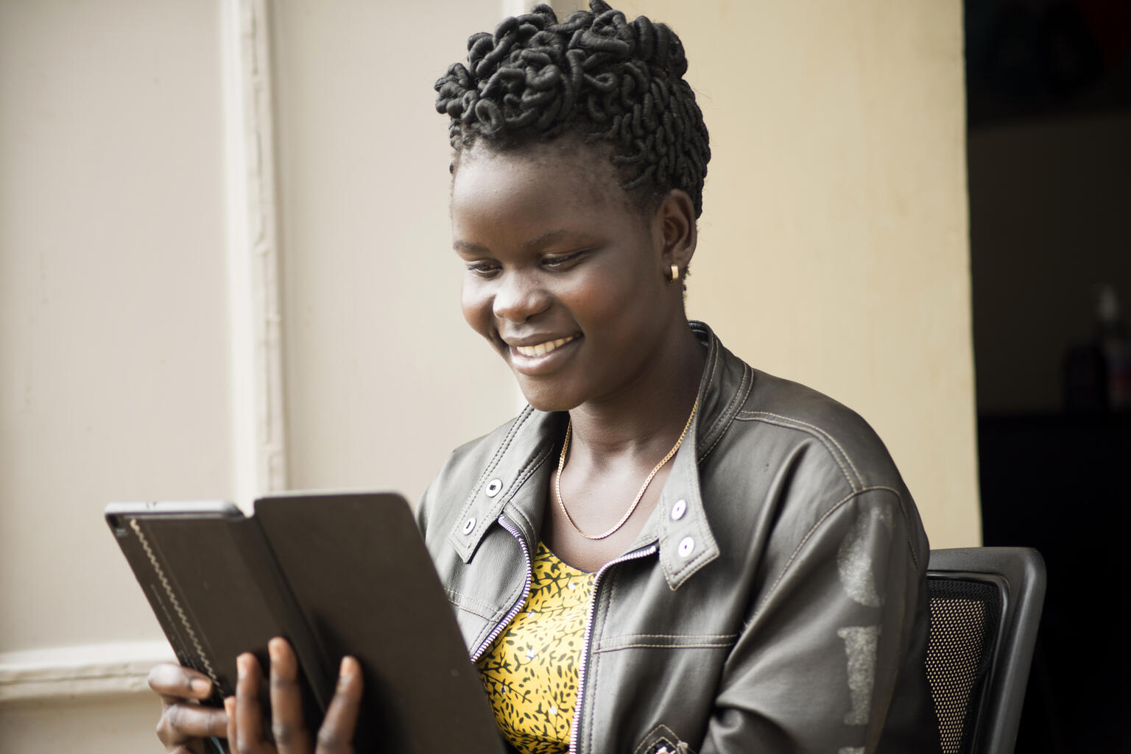
Module 2
Information processing

Slide 3

2
Unit 2: Evaluating data, information and digital content

Slide 4

Assess sources and information online
Ask yourself these questions before using resources from the internet:
Who is the author?
What is the purpose of the site?
Is the information and language objective, unbiased and free of emotional expressions?
Are the factual sources listed so information can be checked?
Is information supported by evidence?
How old is this information?

Slide 5

Evaluate your sources
Use the TAARP method to evaluate your sources:
T – Timeliness
A – Authority
A – Audience
R – Relevance
P – Perspective (point of view)

Slide 6

Evaluate websites
The look and feel of the website
The URL of your results
Are there advertisements on the site?
Check the links on the page
Check when the page was last updated

Slide 7
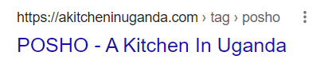
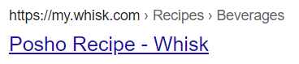
Skills to practise
Question if information is reliable.
Which source would be more reliable – can you say why?
OR
Continue >

Slide 8
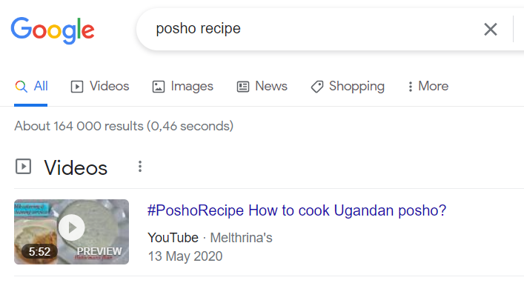
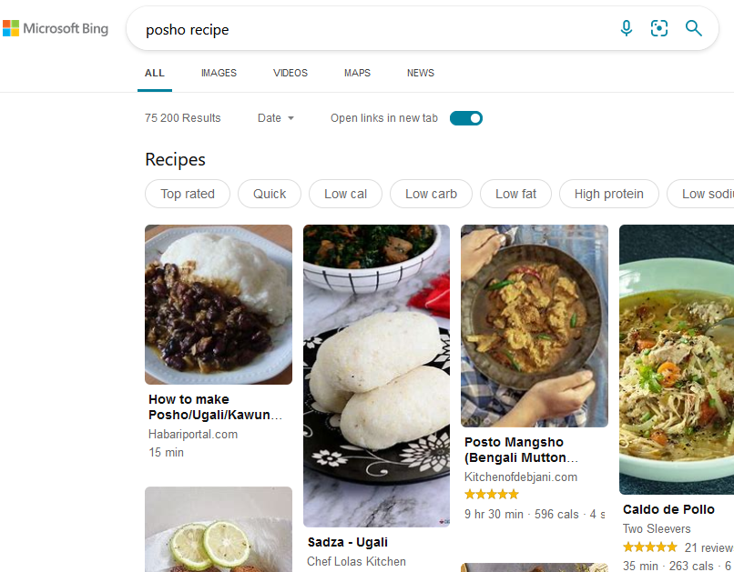
Skills to practise
Compare sites showing similar information to confirm correct information.
Compare these two results. Which result would be easier to use?
OR

Slide 9
All back covers should include
contact information of the section
producing the work.
© United Nations Children’s Fund (UNICEF) [month and year of publication]

